Slide 1


Interaction-Level Charge-Light Matching
v0.3.0: how the algorithm works, and where it fails
Yuxuan Wang (Billy)
PI: Ryan Patterson
ND Prototype Analysis Meeting

Slide 2
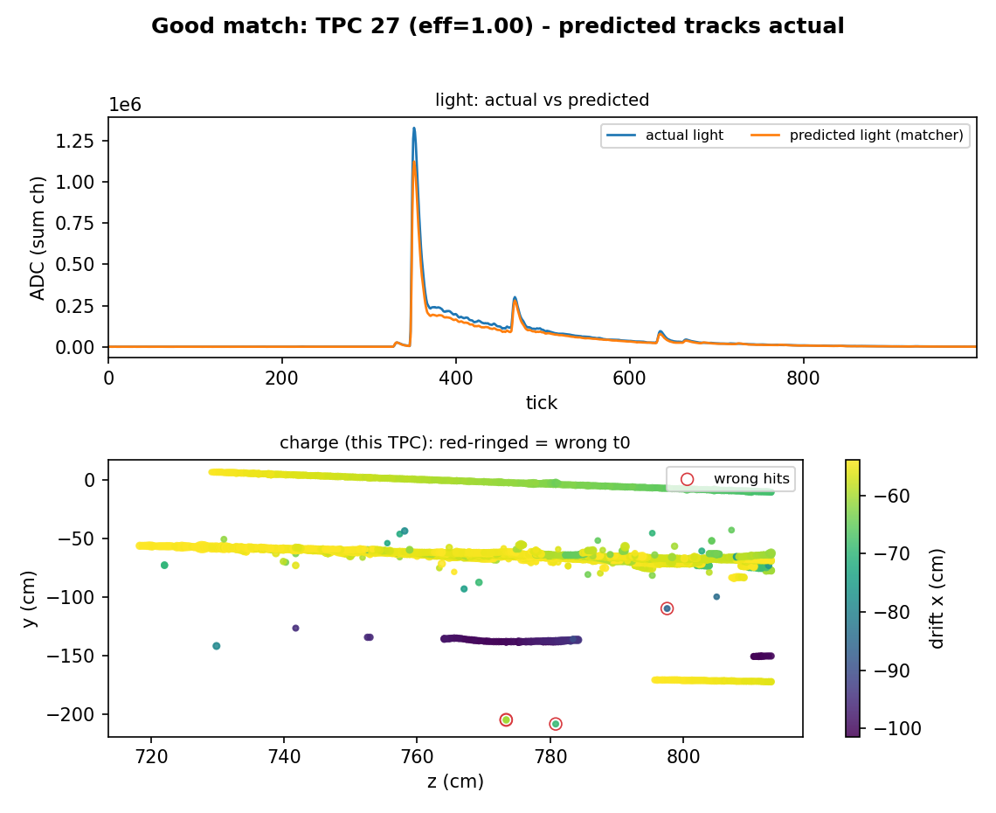
The task: give every charge hit a drift-time t0
ND-LAr spill: many neutrino / rock interactions overlap in each drift volume (TPC)
Charge gives (y,z) and relative drift; the ABSOLUTE t0 (drift x) comes from matching to the scintillation-light flash
Each TPC sees several flashes -> must decide which flash each charge cluster belongs to
Success = |reco t0 - truth t0| <= 10 ticks (160 ns)
v0.3.0 today: 94.9% of all hits correct (95.2% of non-shower energy), 100% coverage
when placements are right, predicted (orange) tracks actual (blue) light
Notes:
The charge tells us where in y-z and how far the electrons drifted, but not the absolute time. The light flash gives the absolute t0. In a busy TPC there are several flashes, so the whole game is deciding which flash each cluster of charge belongs to.

Slide 3
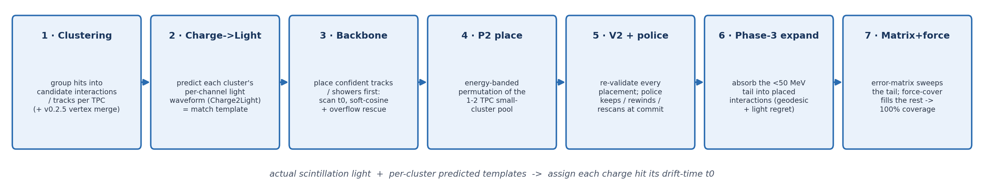
The pipeline at a glance
Strategy: place the confident, high-energy structures first, then peel off progressively smaller / more ambiguous clusters, and force-cover the tail
Notes:
High-level: we lock in the things we're sure about first - long tracks and showers - because they constrain the light budget. Then we work down to the small, dim clusters, and finally force everything to have an answer.

Slide 4
Step 1 - Clustering: find the candidate interactions
Group charge hits into clusters per TPC: straight tracks, showers, blobs
Intuition: one cluster ~ one interaction's charge, and it will receive ONE t0
v0.2.5 vertex-merge: tracks emerging from a common vertex are merged into one multi-prong cluster
  brighter and more constrained -> places as a single unit
Why: fragmented prongs each pick a flash independently -> a classic source of swaps
Notes:
Everything downstream is per-cluster, so clustering decides the units. A key recent addition is vertex-merge: if several prongs share a vertex we treat them as one object, because a bright merged object has a much less ambiguous t0 than a single faint prong.

Slide 5
Step 2 - Predict the light each cluster would make
Charge2Light ML (perceiver): from a cluster's 3D charge, predict its per-channel light waveform
This 'template' is the expected light image if the cluster flashed at t0 = 0
Intuition: shift the template to any candidate t0 and compare to the actual light
The whole matcher = place clusters at t0s so the SUM of templates best explains the actual light
Prediction is ~80% of true amplitude (a systematic) but spatially faithful
a correctly-placed TPC: sum of predicted templates (orange) explains the actual light (blue)
Notes:
This ML step is the heart of it. For each cluster we predict what light it should have made, per channel and per time-tick. Then matching becomes: slide these templates in time and find the arrangement whose sum best reproduces the light we actually saw.

Slide 6
Step 3 - Backbone: place the confident structures first
Order: showers -> >=3-TPC straight tracks -> energy-banded permutation batches for the 1-2 TPC pool
Each placement scans t0; a soft-cosine matched filter picks the best flash (a hard gate hurts)
Intuition: long tracks / showers are bright and span many channels -> their t0 is unambiguous
  lock them first so they constrain everyone else's light budget
Overflow trigger + rescue: unexplained EXCESS light (saturation, >=3 channels excess) means a cluster is mis-placed or a second one is hiding -> Stage A/B repair
Notes:
We don't place everything at once. The bright, long objects have essentially one possible t0, so we commit those first. The overflow trigger is our safety net: if after placing something there's still a big pile of unexplained light, we know we got it wrong or missed a cluster, and we repair.

Slide 7
Step 4 - P2: place the small-cluster pool jointly
The 1-2 TPC clusters left after the backbone are placed in energy order
Energy-banded permutation (batch cap 5; commit N-1, last cluster returns to the pool)
Intuition: within an energy band, jointly test which cluster->flash assignment fits best,
  instead of a greedy one-at-a-time choice that locks in early mistakes
P2-placed cohort accuracy: 92.5% -> 94.0% once the police (next step) is added
Notes:
For the smaller clusters we test permutations within an energy band rather than committing greedily. The idea is that a few similar-energy clusters competing for a few flashes should be decided together.

Slide 8
Step 5 - V2 + placement police: catch mistakes at commit
V2: after placement, re-examine each cluster - would moving it to another flash lower the light loss?
Placement police: every P2 / V2 placement or move is PROBED at its t0 the instant it commits
On alarm (overflow gate fires) resolve immediately: keep / rewind / rescan (rescan usually wins)
Intuition: correct a bad placement BEFORE it corrupts the light budget that later clusters see
Backbone integrity is asserted unchanged through the whole chain
Notes:
V2 is a second-look move stage. The police is stricter: the moment any placement commits we probe it, and if it looks wrong we fix it on the spot, because one bad placement poisons the residual light that everyone downstream matches against.

Slide 9
Steps 6-7 - Phase-3: absorb the tail, then force coverage
Sub-50 MeV clusters carry ~12% of energy but are too dim to place on their own
Expansion: attach each to a placed interaction ('family') by geodesic distance + light 'regret' insertion
  a family sitting at one t0 is bright and pins the attachment
Matrix: an error-matrix sweeps whatever the expansion leaves
Force-coverage: assign everything still unplaced by pure geometry -> 100% coverage
Intuition: a small cluster inherits the t0 of the interaction it physically belongs to
Notes:
The long tail of tiny clusters can't be matched on their own light. Instead we attach them to the bright interaction they geometrically belong to and let them inherit its t0. Force-coverage is the final mandate that nothing is left unassigned.

Slide 10
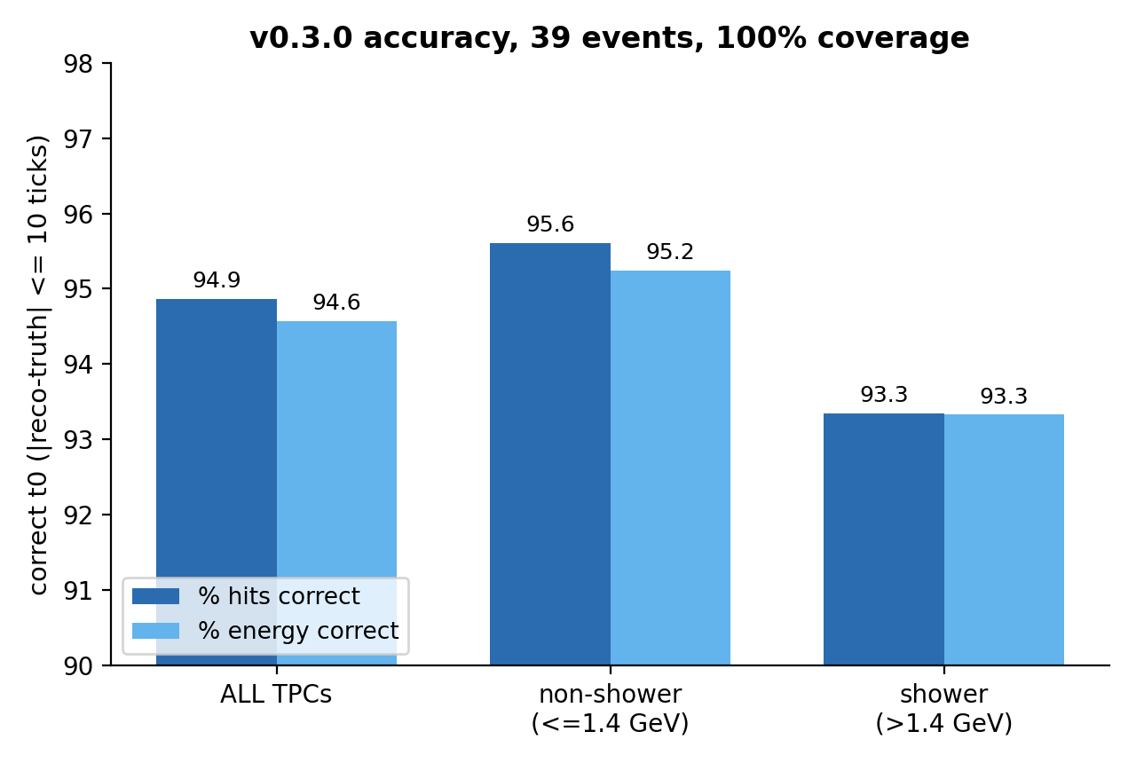
Where we stand: v0.3.0 accuracy
94.9% of ALL hits get the correct t0 (94.6% energy-weighted)
Non-shower TPCs (<=1.4 GeV): 95.2% of energy correct
Shower TPCs (>1.4 GeV): 93.3% - a dedicated approach comes later
100% coverage (force-coverage assigns everything)
39 MiniProdN5p1 events; |reco-truth| <= 10 ticks
Notes:
These are energy-weighted, 100% coverage numbers. The shower walls above 1.4 GeV are the weakest and we've scoped a separate path for them.

Slide 11
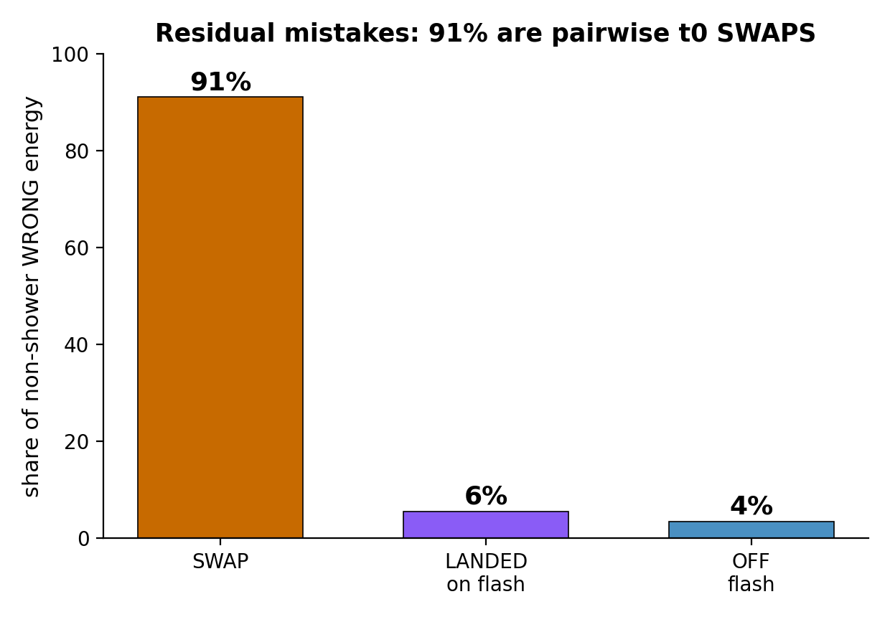
Where it fails: 91% of mistakes are t0 SWAPS
Non-shower wrong energy = 4.0% of truth energy - and it is highly structured
SWAP (91%): two interactions in one TPC each get the OTHER's flash
LANDED (5.5%): grabbed a real flash owned by a neighbouring TPC (shared light)
OFF-flash (3.5%): placement drifts a few ticks past the 10-tick cut
Clustering is correct - only the t0 LABELS move
Notes:
This is the most important slide. The residual error is not random dust - 91% of it is one failure mode: two real interactions swapping their flashes. That tells us it's a matching-policy problem, not a light-prediction problem.

Slide 12
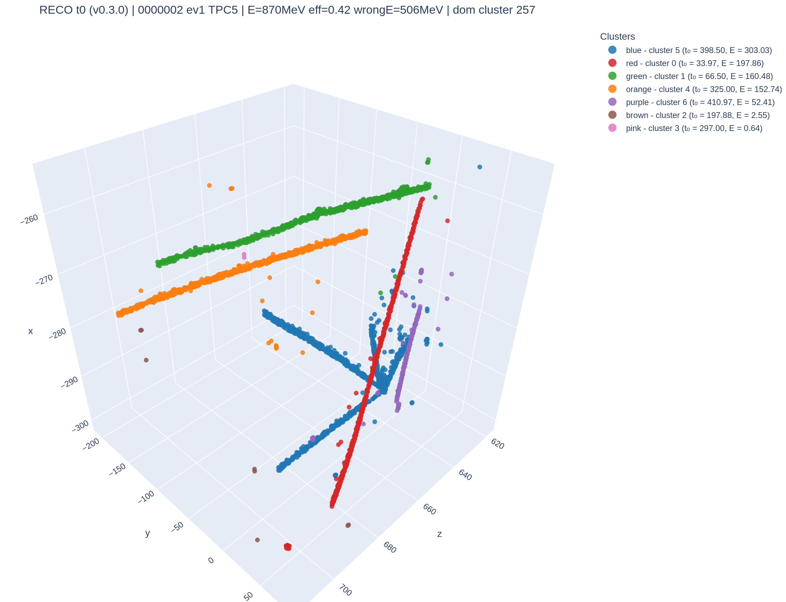
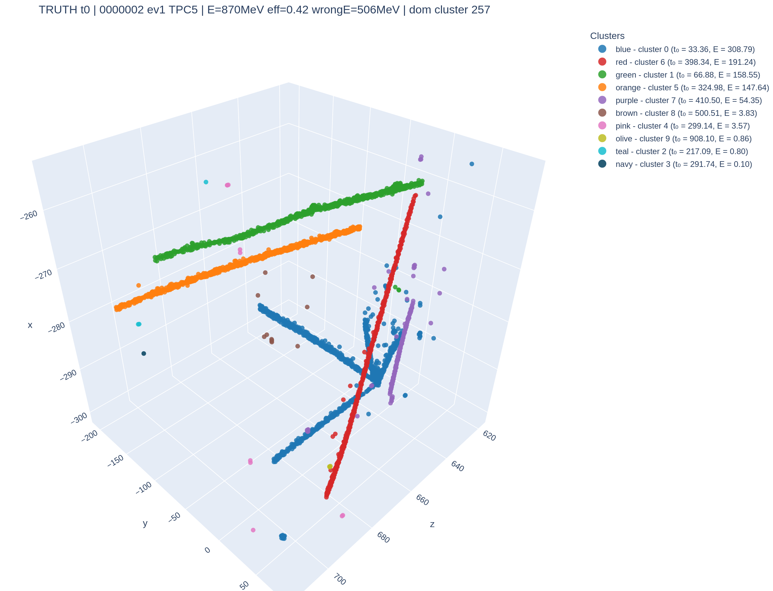
The swap, seen in 3D (TPC 5)
Same charge, same clusters - only the t0 grouping differs between reco and truth
The wrong hits form whole coherent tracks, not scattered noise
RECO t0 (matcher)
TRUTH t0
Notes:
Left is what the matcher decided, right is truth. Notice the two big clusters have simply exchanged their colours - their t0 labels are swapped. The clustering is perfect; only the time assignment is wrong.

Slide 13
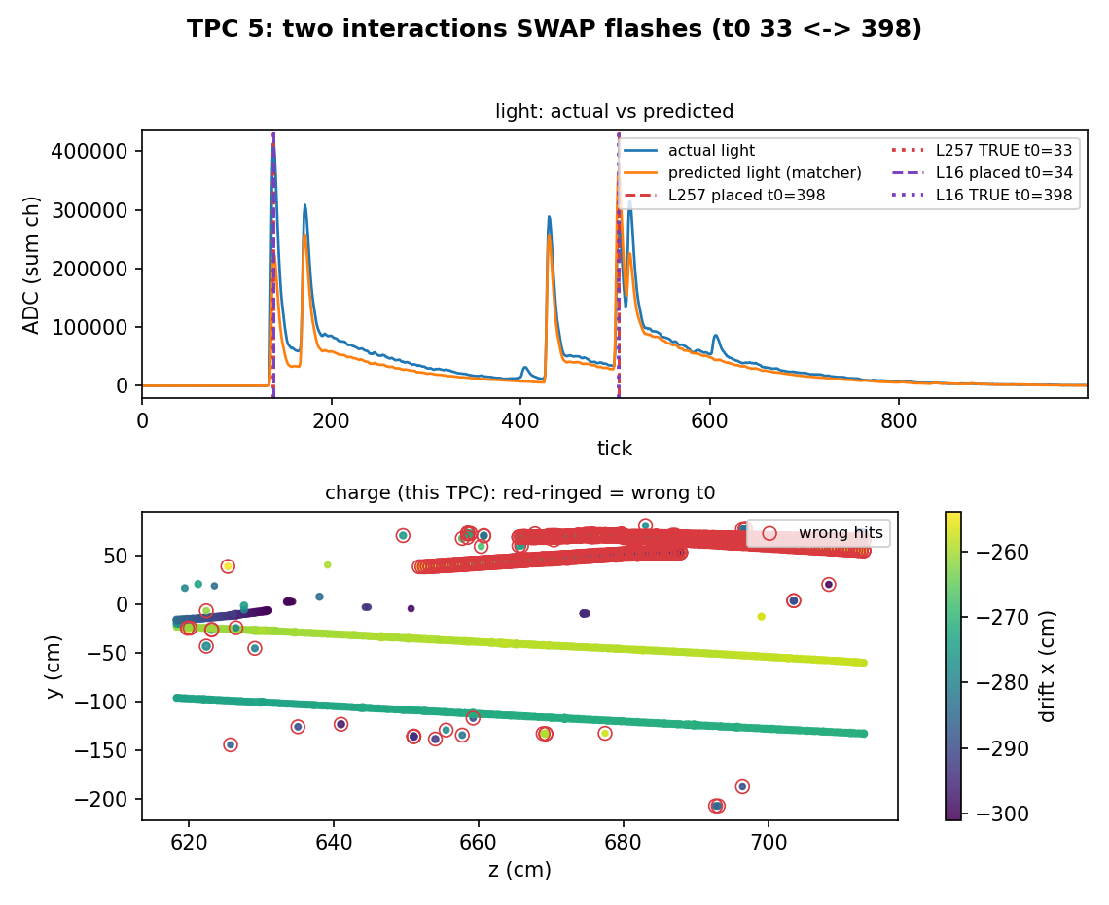
The swap in the light: two real flashes, crossed
L257 (295 MeV): truly at t0=33, but placed at 398
L16 (185 MeV): truly at 398, but placed at 34
BOTH t0 are real, bright flash peaks
-> the summed light is near-degenerate under the swap
Wrong hits (red rings) = the whole track that got the wrong flash
Notes:
Here's the same event in the light. Both 33 and 398 are genuine flashes, and both clusters emit light, so swapping which cluster sits at which flash barely changes the total predicted light. That degeneracy is exactly why the mistake survives.

Slide 14
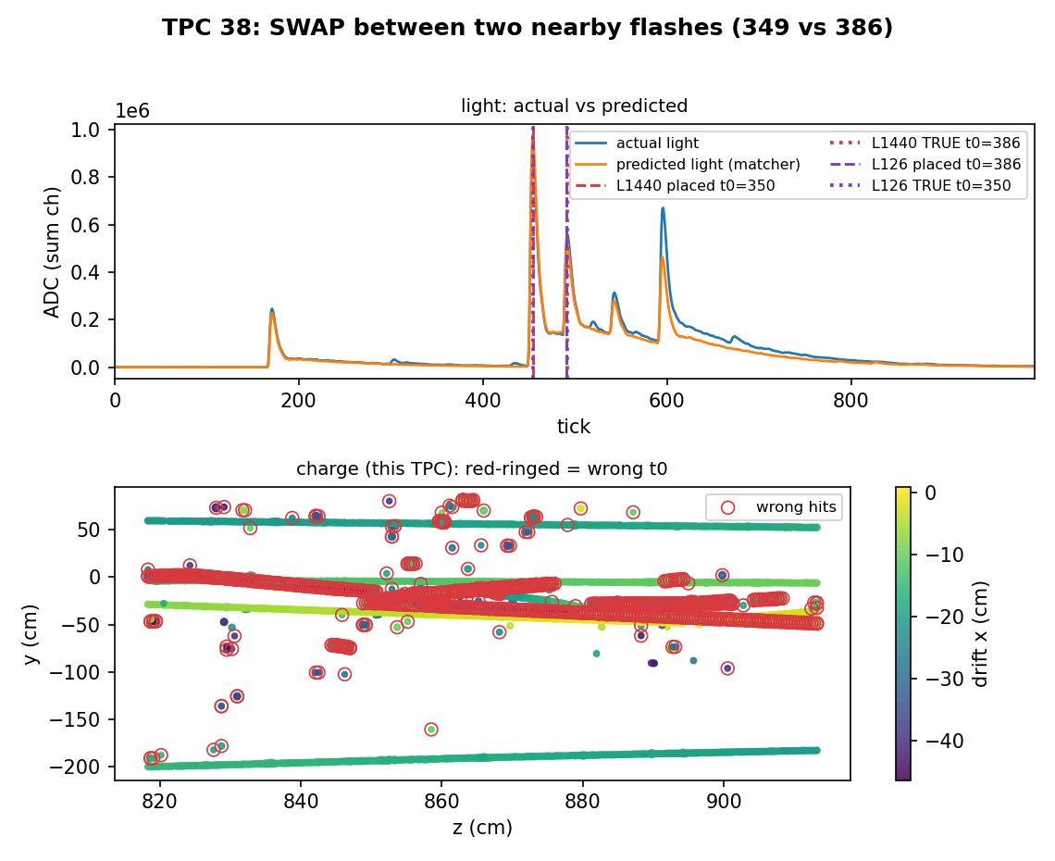
Why swaps survive - three reinforcing gaps
1. Never tested: clusters are grouped by reco-t0, so the two swap partners land in different groups and the swap permutation is never co-scored
2. Degenerate objective: both flashes bright -> summed light barely moves under the swap; a greedy 'biggest cluster -> brightest flash' bias
3. No anchor: the swapped cluster's flash trigger did not fire (or was overridden)
All fixable: the correct flash IS present in the TPC
TPC 38: two flashes only 37 ticks apart get crossed
Notes:
Three things line up. We never even test the swap because the two clusters are in different time groups. Even if we did, the summed-light score can't tell them apart. And the flash trigger that could have anchored the right answer didn't fire confidently.

Slide 15
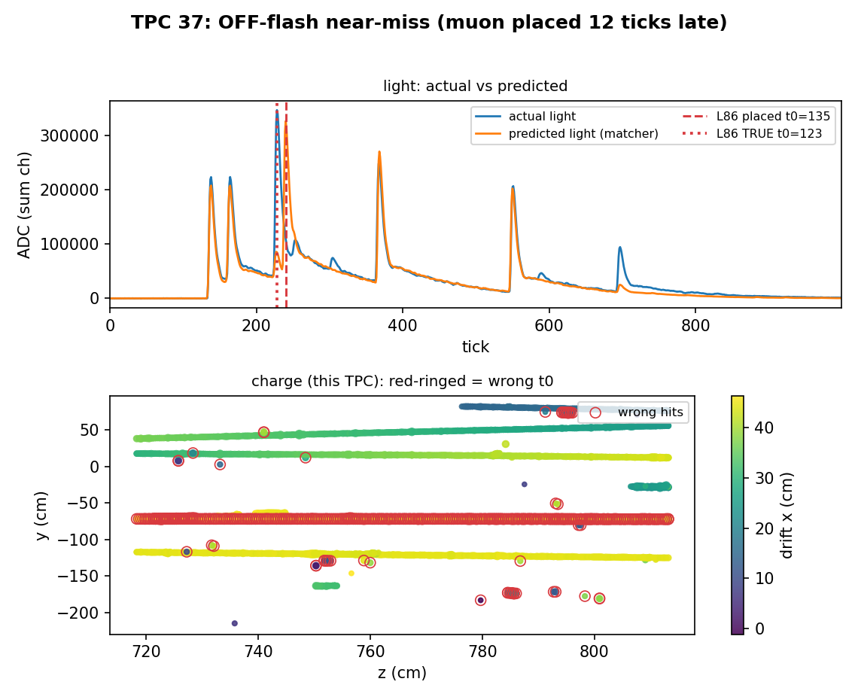
Minority failure modes
LANDED (5.5%): a long through-going muon grabs a real flash whose charge is in ANOTHER TPC (light is shared across TPCs)
OFF-flash (3.5%): the flash trigger found the right t0, but the placement drifted ~12 ticks
  just over the 10-tick cut -> a near-miss, largely benign
Both involve long tracks whose light is spread / shared -> ambiguous association
TPC 37: a 6-TPC muon placed 12 ticks late (135 vs true 123)
Notes:
The rest is two small classes, both about long tracks whose light is spread across TPCs. The off-flash ones are near-misses - the trigger was right, the placement just drifted a couple ticks past our cut.

Slide 16
Summary and next steps
v0.3.0 full chain: 94.9% all-hits / 95.2% non-shower energy, 100% coverage
Dominant residual = pairwise t0 swaps (91%) - a matching-policy problem, not light availability
Discriminator validated: a saturation-masked per-channel SPATIAL cosine prefers the correct t0 (7/7 clean cases)
  a swap-fix pass recovers the big clean swaps (e.g. +1.4pp on the worst TPC)
  but net-neutral as a blanket pass (broad light -> small margins); need energy-weighted / joint assignment
Next: dedicated handling for shower TPCs (>1.4 GeV)
Notes:
To close: the model is solid and the pipeline is at ~95% on the interesting cohort. The remaining error is almost entirely swaps, which is encouraging because it's a policy problem we can attack. We have a discriminator that works on clean cases; making it a reliable blanket pass is the next step.

